Slide 1
PREDICTIVE MAINTENANCE FOR INDUSTRIAL EQUIPMENT
PROJECT
Presented By:
1. RAJ GUPTA-ITM SLS BARODA UNIVERSITY-B.TECH CSE

Slide 2
OUTLINE
Problem Statement
Proposed System/Solution
System Development Approach
Algorithm & Deployment
Result
Conclusion
Future Scope
References

Slide 3
Problem Statement
Statement: In many industries, unexpected equipment failures can result in significant downtime, maintenance costs, and production losses. To address this issue, the goal is to develop a predictive maintenance system using machine learning algorithms. The focus will be on a specific type of industrial equipment (e.g., pumps, motors, turbines) where failure can have severe consequences.

Slide 4
Proposed Solution
Data Collection: Gather historical data related to the equipment, including sensor readings, operating conditions, and failure instances. The dataset should include information on both normal and failure states.
Feature Engineering: Identify relevant features and engineering new ones that can provide insights into the health of the equipment. This may involve time-series analysis, frequency domain analysis, or other signal-processing techniques.
Labeling: Develop a labelling mechanism for the dataset to distinguish between normal operating conditions and impending failure. This might involve defining threshold values or using expert-labeled data.
Algorithm Selection: Choose appropriate machine learning algorithms for predictive maintenance, such as Random Forests, Support Vector Machines, or Deep Learning models. Consider the trade-off between model complexity and interpretability.
Model Training and Validation: Split the dataset into training and validation sets, and train the chosen algorithm. Optimize hyperparameters to ensure the model generalizes well to unseen data. Validate the model using metrics like precision, recall, and F1 score.
Deployment: Implement the trained model in a real-time or near-real-time environment where it can continuously monitor equipment health. Integrate the predictive maintenance system with the existing infrastructure.

Slide 5
System Approach
The system approach to a predictive maintenance program involves understanding the entire system in which the program operates, considering various components, interactions, and their impact on the overall objectives. Here's a system approach breakdown for the predictive maintenance program:
Define Objectives
Understand the System
Data Collection and Integration
Preprocessing and Feature Engineering
Machine Learning Model
Deployment
Real-Time Monitoring
Alerting and Reporting
Feedback Loop
Documentation
Training and Knowledge Transfer
Continuous Improvement
Compliance and Regulations

Slide 6
Algorithm & Deployment
Algorithm Selection:
Random Forest
Why Random Forest?
Random Forest was chosen for predictive maintenance in industrial equipment due to its robustness, versatility, and suitability for the task at hand. Several factors contributed to this choice:
Robustness: Random Forest is less prone to overfitting, making it suitable for complex datasets with various features.
Handling Non-linearity: It can capture non-linear relationships between input features and equipment failure, which is crucial for predictive maintenance tasks.
Feature Importance: Random Forest provides insights into feature importance, aiding in understanding the factors contributing to equipment health.
Data Input:
Kaggle Dataset Link: Predictive Maintenance Dataset
The Kaggle dataset provided the necessary information for training and evaluating the predictive maintenance model. It includes features such as air temperature, process temperature, rotational speed, torque, tool wear, and failure indicators. The dataset was split into training and testing sets to train the model and assess its performance.

Slide 7
Continue….
Training Process:
Training the Random Forest Model
Data Exploration: Analyzing the dataset to understand feature distributions, correlations, and identifying potential patterns.
Data Preprocessing: Handling missing values, scaling numerical features, and encoding categorical variables for compatibility with the machine learning model.
Feature Selection: Selecting relevant features based on domain knowledge and data exploration.
Splitting Data: Dividing the dataset into training and testing sets to assess the model's performance on unseen data.
Model Initialization: Choosing Random Forest as the machine learning algorithm and initializing it with parameters.
Model Training: Training the model on the training set to learn the patterns and relationships between features and equipment failure.

Slide 8
Continue….
Prediction Process:
Making Predictions with the Trained Model
Data Input: Providing new or unseen data with features like air temperature, process temperature, etc.
Feature Engineering (if applicable): Applying the same preprocessing steps used during training to ensure compatibility.
Model Prediction: Using the trained Random Forest model to predict the likelihood of equipment failure based on the input features.
Outcome: Obtaining a binary prediction (0 or 1) indicating the absence or presence of potential failure.

Slide 9
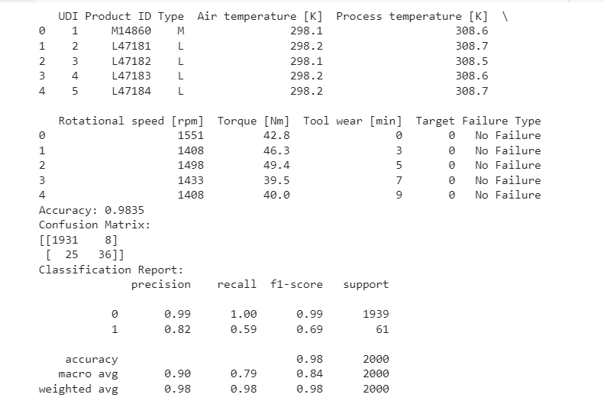
Result

Slide 10
Model Evaluation Metrics:
Accuracy: 98.35%
This indicates the proportion of correctly classified instances in the test set.
Confusion Matrix:
[[1931 8]
[ 25 36]]
Rows represent actual classes, and columns represent predicted classes.
1931 instances of class 0 were correctly predicted as class 0.
8 instances of class 0 were incorrectly predicted as class 1.
25 instances of class 1 were incorrectly predicted as class 0.
36 instances of class 1 were correctly predicted as class 1.

Slide 11
Classification Report:
Precision: The ability of the classifier not to label a positive instance as negative.
Recall: The ability of the classifier to find all positive instances.
F1-score: The harmonic mean of precision and recall.
Support: The number of actual occurrences of the class in the specified dataset.

Slide 12
Conclusion
In conclusion, the predictive maintenance program for industrial equipment, utilizing the Random Forest algorithm, presents a promising solution for enhancing operational efficiency and minimizing downtime. Leveraging a Kaggle dataset for comprehensive feature information, the program underwent a systematic training process, incorporating data exploration, preprocessing, and feature selection. The trained model demonstrated its ability to predict equipment failures, and upon deployment, it integrates seamlessly into the operational environment for real-time monitoring. The continuous improvement framework, including feedback mechanisms and periodic updates, ensures the model's adaptability to evolving equipment conditions. The program holds significant potential for cost savings, improved reliability, and a proactive approach to maintenance, setting the stage for a more efficient industrial ecosystem. Challenges such as imbalanced datasets are acknowledged, and future considerations may involve exploring advanced machine-learning techniques for further refinement. machine-learning

Slide 13
Future scope
The future scope of this predictive maintenance project is extensive, with opportunities to enhance its capabilities and impact. The incorporation of more advanced machine learning techniques, such as deep learning models, could potentially improve prediction accuracy and handle intricate patterns in equipment behaviour.
Integration with real-time data streams and the Internet of Things (IoT) could further refine the model's responsiveness and provide more timely insights. Exploring additional relevant features and considering a multi-modal approach, such as combining sensor data with external factors like environmental conditions, could contribute to a more comprehensive understanding of equipment health. Collaboration with industry experts and stakeholders may open avenues for domain-specific optimizations, and expanding the project to a broader range of industrial settings could diversify its applications.
Additionally, ongoing research in explainable AI methods would address the interpretability of the model's decisions, instilling confidence among end-users and facilitating regulatory compliance. Overall, the future scope involves a continual evolution of the project, leveraging emerging technologies and insights to advance predictive maintenance in industrial settings.

Slide 14
References
Kaggle for dataset:
https://www.kaggle.com/
StackOverflow for errors:
https://stackoverflow.com/

Slide 15
THANK YOU

